Slide 1
Chapter Two
Programming with numbers and strings, Standard input and output

Slide 2
Introduction
Numbers and character strings are 2 basic data types in any Python program. These are the fundamental building blocks that we use to build more complex data structures.
Numbers in Python can be:
integers or whole numbers: 27, -3, 0, 2684
floating point numbers or numbers with decimal point: 2.393, -3.7, 0.0558624
complex numbers with real and imaginary parts: 2 + 3j, 1.42 - 0.852j
Strings in Python are a sequence of characters that can be single or double quoted: ‘123 Main St.’ , “Python Programming”
A character is a string of 1 element.

Slide 3
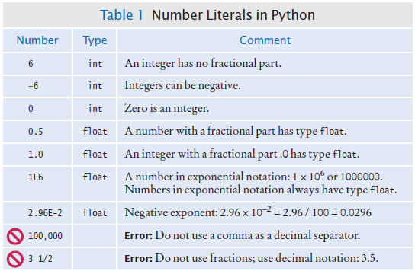
Number Literals in Python
Number literals can appear in a program in the following format:

Slide 4
Variables

Slide 5
Variables
A variable is a named memory location in a computer program that is used to temporarily store data for the program.
A variable can store any type of data (numbers or strings) and the data can be small or large size.
Internally all data in Python are stored in Python objects.
We define or create a variable by telling the compiler:
The variable name that we will use to refer to it
The initial value of the variable
The name of a variable is a reference to the memory location that holds the data.

Slide 6
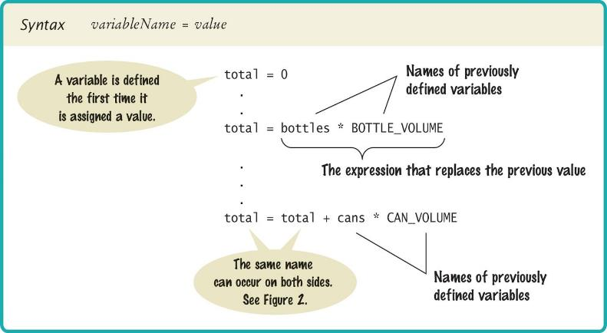
The Assignment Statement
Use the assignment operator '=' to place a data value into a variable.
Python supports the swapping of 2 or more data values with an assignment:
var1, var2 = var2, var1

Slide 7
Data Types and Variables
There are three basic types of data that we will use in this chapter:
int A whole number
float A number with a decimal point
str A sequence of characters that is quoted
The data type is associated with the data value, not the variable name:
num = 6
num
6
num is a reference to the memory location that holds the data 6, which is an int
num = 12.4
num
6
12.4
num is now a reference to the memory location that holds the data 12.4, which is a float

Slide 8
Find the Data Type
Use the function type to check for the data type of a variable.
From the previous example with the variable num, we see the following Python code and their output at the shell:
>>> num = 6
>>> type(num)
<class 'int'>
>>> num = 12.0
>>> type(num)
<class ‘float'>

Slide 9
Naming Variables
Variable names should describe the purpose of the variable.
Example: canVolume is better than cv or x
Use These Simple Rules
Variable names must start with a letter or the underscore ( _ ). Continue with letters (upper or lower case), digits, or underscore.
Don’t use punctuation (? or %...) or space.
Separate words with camelCase notation: taxRate Or use underscore to separate words: tax_rate
Don’t use reserved words (see Appendix C, pages A6 and A7).
Just as anything else in Python, variable names are case sensitive.

Slide 10
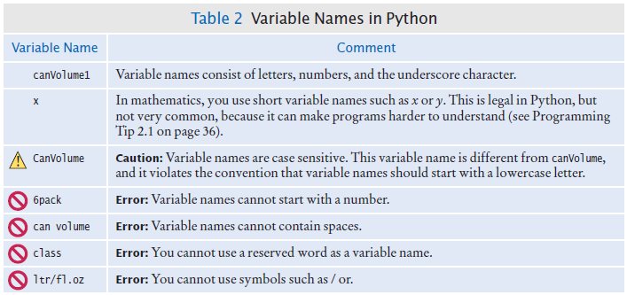
Variable Names in Python

Slide 11
Undefined Variables
We must define a variable before we can use it.
The following code will cause syntax error:
The correct order for the statements is:
canVolume = 12 * literPerOunce
literPerOunce = 0.0296
What is literPerOunce?
literPerOunce = 0.0296
canVolume = 12 * literPerOunce

Slide 12
Constants
In Python a constant is a variable whose value should not be changed after it’s assigned an initial value.
It is a good practice to use all caps when naming constants
It is good style to use named constants to explain numerical values to be used in calculations.
Which of the two statements below is clearer?
Python will let us change the value of a constant, just like how we change the value of a variable.
Just because we can do it doesn’t mean we should do it.
BOTTLE_VOLUME = 2.0 # Constant
MAX_SIZE = 100 # Constant taxRate = 5 # Variable
totalVolume = numBottles * 2.0
totalVolume = numBottles * BOTTLE_VOLUME

Slide 13
Comments
Use comments at the beginning of each program and throughout the program to clarify details of the code.
Comments add explanation for humans who read your code and are a way to document your thinking.
The Python interpreter ignores all comments when it translates the code to bytecode.
A comment starts with the # symbol and ends at the end of the line
To create a comment block, start and end the comment block with a sets of:
3 single quotes: ’’’ comments ’’’
3 double quotes: ””” comments ”””

Slide 14
Commenting Code Example
# This program computes the volume (in liters) of a six-pack of soda
# cans and the total volume of a six-pack and a two-liter bottle
## CONSTANTS ##
CAN_VOLUME = 0.355 # Liters in a 12-ounce can
BOTTLE_VOLUME = 2 # Liters in a two-liter bottle
# Number of cans per pack
cansPerPack = 6
# Calculate total volume in the cans
totalVolume = cansPerPack * CAN_VOLUME
print("A six-pack of 12-ounce cans contains", totalVolume, "liters.")
# Calculate total volume in the cans and a 2-liter bottle
totalVolume = totalVolume + BOTTLE_VOLUME
print("A six-pack and a two-liter bottle contain", totalVolume, "liters.")
’’’
Program output:
A six-pack of 12-ounce cans contains 2.13 liters.
A six-pack and a two-liter bottle contain 4.13 liters.
’’’

Slide 15
Arithmetic

Slide 16
Basic Arithmetic Operations
Python supports all of the basic arithmetic operations:
Addition +
Subtraction -
Multiplication *
Division /
Modulus %
Exponent **
Integer division // (also called floor division)
Python supports update operators by adding a = after each arithmetic operator above
Example: Addition then assign +=
count += 5 # same as: count = count + 5

Slide 17
Precedence and Mixed Numeric Types
Precedence is the same as in math:
PEMDAS: Parenthesis, Exponent, Multiply/Divide, Add/Subtract
If two operators have the same precedence (ie. multiply and divide) then the order is from left to right.
Assignment operators ( = as well as += ) have the lowest precedence.
In an expression with mixed integer and floating point values, the result is promoted to a floating point value.
7 + 4.0 # Yields the floating value 11.0

Slide 18
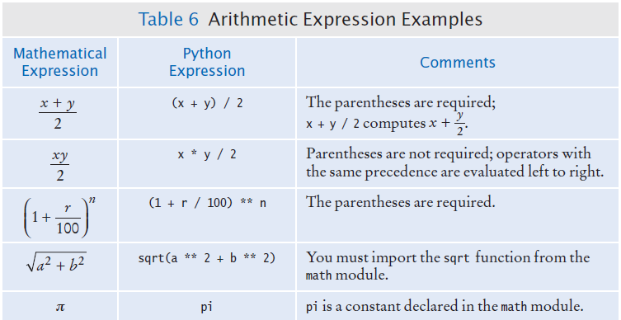
Arithmetic Expressions

Slide 19
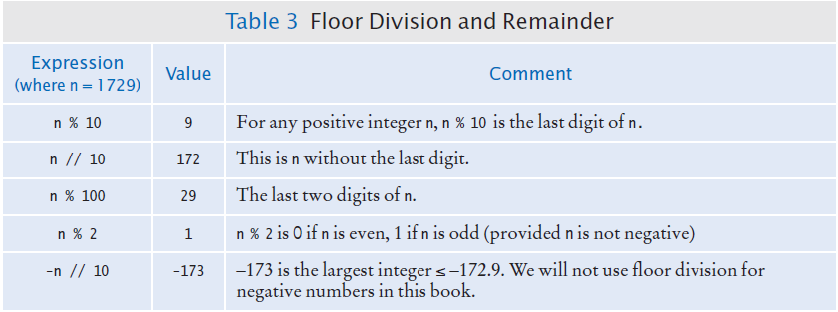
Integer Division and Remainder Examples
Handy to use for making change:
pennies = 1729
dollars = pennies / 100 # 17
cents = pennies % 100 # 29

Slide 20
Binary Data
In addition to arithmetic operators, Python provides bitwise operators that work with the binary format (raw format) of data.
Data in memory are in binary format, which is a sequence of 0’s and 1’s.
Example: the number 52 in base 10 is stored in memory as the following 8-bit binary value:
Binary data typically have 8, 16, 32, or 64 bits, depending on the size of the data.
To convert a base 10 data value to binary, keep dividing the value (integer division) until the quotient is 0. The remainder of each integer division form the binary value.
Example of converting the value 12 to binary: 12 / 2 = 6 R 0, 6 / 2 = 3 R 0, 3 / 2 = 1 R 1, 1 / 2 = 0 R 1 => 1100 Adding leading 0 to turn it into an 8-bit value: 0000 1100
To convert a binary value to base 10, sum up all the powers of 2 where the bit is 1. The powers of 2 starts with 2^0 at the right most bit.
Example of converting 0000 1010: 2^1 + 2^3 = 2 + 8 = 10 decimal
0
0
1
1
0
1
0
0

Slide 21
Bitwise Operators
Python provides the following bitwise operators
Operator | Name | Example | Output if num is 3 or 0000 0011
<< | Left shift | num << 1 | 6 or 0000 0110
>> | Right shift | num >> 1 | 1 or 0000 0001
& | Bitwise and | num & 2 | 2 or 0000 0010
| | Bitwise or | num | 2 | 3 or 0000 0011
^ | Exclusive or | num ^ 2 | 1 or 0000 0001
~ | Complement | ~num | -4 or 1111 1100

Slide 22
Use of Bitwise Operators
Some operations with numbers are faster if we use bit-wise operation.
To do an integer division by a power of 2: shift right the data
To do a multiplication of an integer by a power of 2: shift left the data
To zero out bits of an integer: do a bitwise AND with 0
To set bits of an integer to 1: do a bitwise OR with 1
To toggle certain bits (turn 1 to 0 or 0 to 1): do a bitwise exclusive-or with 1

Slide 23
Calling Functions
Recall that a function is a block of programming instructions that carry out a particular task.
The print function can display information, but there are many other functions available in Python.
When calling a function we must provide the input argument(s) that the function needs to do its task.
Most functions return a value when the function completes its task.
Example:
The call:
And the returned value can be stored in a variable:
Or we can use a function call as an argument to another function:
abs(-173) # returns the absolute value 173
distance = abs(-173)
print(abs(-173)) # the returned value of abs # becomes the input for # print

Slide 24
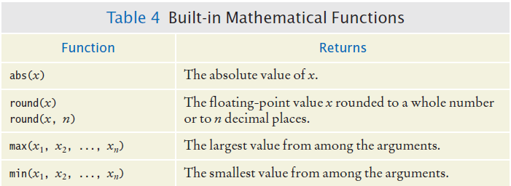
Common Built-in Math Functions
Built-in functions are a small set of functions that are part of the Python language. They can be used without importing any modules.

Slide 25
Python Modules (Libraries)
A library is a collection of code, written and compiled by someone else, that is ready for us to use in a program.
A standard library is a library that is considered part of the language and must be included with any Python system.
Python’s standard library is organized into modules.
Related functions and data types are grouped into the same module.
Functions defined in a module must be explicitly loaded into your program before they can be used.

Slide 26
Using Functions from the Math Module
Functions in a module must be imported into the program before they can be called.
There are 2 ways to import a module and work with it.
Import entire math module:
Import only the function or data that we need:
# At the top of the program:
import math
# Then call the square root function of the math module:
y = math.sqrt(x)
# At the top of the program:
from math import sqrt
# Then simply call the square root function:
y = sqrt(x)

Slide 27
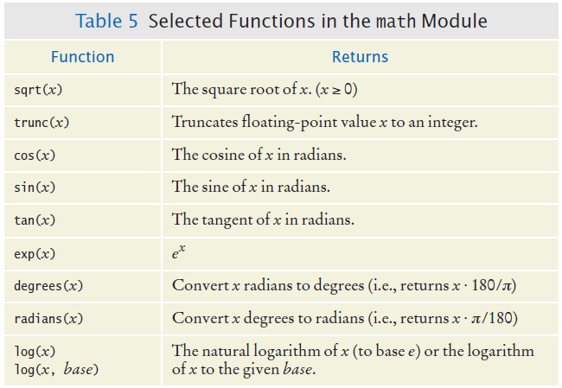
Common Math Module Functions
In addition, pi is also stored in the math module: 2 * math.pi * r

Slide 28
Data Type Conversion for Numbers
The function int() and float() convert between integer and floating point values.
Example:
When converting from float to int, we lose the fractional part of the floating-point value (truncating, not rounding).
balance = total + tax # balance: float
dollars = int(balance) # dollars: int

Slide 29
Roundoff Errors
Floating point values are not exact.
This is a limitation of binary values: not all floating point numbers can have an exact representation because they go on indefinitely and computers work with a finite number of bits.
Example:
We can work around the roundoff errors by:
Rounding to fewer digits by using the round() function
Printing with formatting so there is a fixed number of digits after the decimal point
price = 4.35
quantity = 100
total = price * quantity # total should be: 435.00
print(total) # print: 434.99999999999994

Slide 30
Complex Numbers
In addition to integers and floats, Python also supports complex numbers.
The following are examples of complex numbers at the shell:
There is a cmath (for complex math) module that has math functions for complex numbers.
>>> x = 2 + 3j
>>> print(x)
(2+3j) # rectangular format, real + imaginary parts
>>> print(x.real, x.imag)
2.0 3.0
>>> print(polar(x))
(3.605551275463989, 0.982793723247329) # polar format,
# magnitude and angle

Slide 31
Problem Solving

Slide 32
Steps in Problem Solving
A very important step for developing an algorithm is to first figure out the computations by hand.
If we can’t figure out a solution by hand, then we would not be able to write the program.
Start with a few example data values and compute the result with them.
The step by step computation will become our algorithm to solve the problem.
Test our algorithm with other sample data values to make sure it works for multiple input values.
Convert the step by step algorithm into Python statements.

Slide 33
Strings

Slide 34
Strings
A string is a sequence of characters:
Characters are letters, numbers, punctuation marks, spaces…
In Python, string literals are specified by enclosing a sequence of characters within a matching pair of either single or double quotes.
By allowing both types of delimiters, Python makes it easy to include an apostrophe or quotation mark within a string.
Remember to use matching pairs of quotes, single with single, double with double.
print("This is a string", 'So is this.')
message = 'He said "Hello" to me'

Slide 35
String Length
The number of characters in a string is called the length of the string.
Example, the length of "Harry" is 5
We can compute the length of a string using the len function:
A string of length 0 is called the empty string. It contains no characters and is written as 2 double quotes "" or 2 single quotes '' next to each other.
A character is a string with length 1: ‘P’ has data type str.
length = len("World!") # length is 6

Slide 36
String Concatenation with +
We can ‘add’ one string onto the end of another or append a string by using the + operator:
To put a space in between the two names?
Using + to concatenate strings is an example of a concept called operator overloading. The + operator behaves differently depending on the data types of the operands (numbers or strings).
firstName = "Harry"
lastName = "Morgan"
name = firstName + lastName # name is: HarryMorgan
name = firstName + " " + lastName # name is: Harry Morgan

Slide 37
String Repetition with *
We can replicate a string multiple times with the * operator.
Example: to print a dashed line, instead of typing a literal string with 50 dashes, we use the * operator to create a string that is comprised of the string "-" repeated 50 times.
results in the string dashedLine:
The * operator is also overloaded. It behaves differently depending on the data type of the operands.
dashedLine = "-" * 50
-------------------------------------------------

Slide 38
Converting Numbers to/from Strings
Use the str() function to convert between numbers and strings.
Examples:
To turn a string containing a number into a numerical value, we use the int() and float() functions:
The conversion from string to number is important when the strings come from the keyboard as user input.
balance = 123.45
dollars = 88
balanceString = str(balance) # balanceString: “123.45”
dollarsString = str(dollars) # dollarString: “88”
id = int("1729") # id: 1729
price = float("17.29") # price: 17.29

Slide 39
Characters in a String
Python uses Unicode characters
Unicode defines over 100,000 characters.
Unicode was designed to be able to encode text in essentially all written languages.
Characters are stored as integer values
See the ASCII subset on Unicode chart in Appendix A
For example, the letter ‘H’ has a value of 72
Use chr and ord functions to convert between a character and its ASCII value.
Examples at the shell:
>>> ord('A') # convert character to ASCII value
65
>>> chr(66) # convert ASCII value to character
'B'

Slide 40
Accessing a Character from a String
Each character inside a string has an index number:
0 | 1 | 2 | 3 | 4 | 5 | 6 | 7 | 8 | 9
c | h | a | r | s |  | h | e | r | e
The first character is at index 0
The [] operator returns a char at a given index inside a String:
name = "Harry”
start = name[0]
last = name[4]
0 | 1 | 2 | 3 | 4
H | a | r | r | y

Slide 41
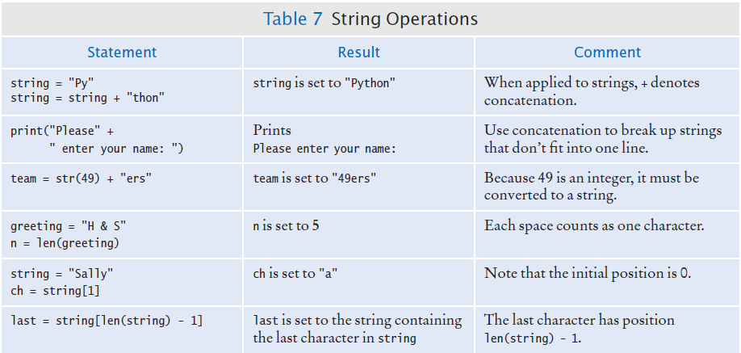
String Operations

Slide 42
Methods of an Object
In programming, an object is a “smart” data type that contains data values and has certain behavior.
The data value can be simple, such as an integer, or it can be complex, such as a graphical window.
The behavior of an object is determined by its methods.
A method is similar to a function in that it accepts input data and does a specific task with the input data.
But unlike a function, which is a standalone operation, a method can only be used with an object of the type for which it was defined.
Methods can only be called from a specific type of object.
Functions are general and can be called without an object.
Example: a string object has the upper() method
name = "John Smith"
uppercaseName = name.upper()
# uppercaseName is "JOHN SMITH"

Slide 43
Common String Methods
Common string methods
Methods | Explanation | Example s = “this is Python!” | Returned value
upper() | Returns a string in all uppercase | s.upper() | “THIS IS PYTHON!”
lower() | Returns a string in all lowercase | s.lower() | “this is python!”
replace() | Returns a string with replaced substrings | s.replace(“is”, “was”) | “thwas was Python!”
title() | Returns a string with uppercase first letter in each word | s.title() | “This Is Python!”

Slide 44
String Escape Sequences
To print a double quote inside a double quoted string:
Preface the " with a “\” inside the double quoted String
Similarly, use \’ to print a single quote inside a single quoted string
To print a backslash
Preface the \ with another \
Common escape sequences inside strings
Newline: ‘\n’
Tab: ‘\t’
print("He said \"Hello\"") # output: He said "Hello"
print("C:\\Temp\\Secret.txt") # output: C:\Temp\Secret.txt

Slide 45
Input and Output

Slide 46
Reading in Input
Use the input function to read a string from the keyboard:
The input function accepts a single string to be used as the prompt.
The return value of the input function is always a text string.
If the input needs to be converted to a number:
The above is equivalent to the two steps:
name = input("Please enter your name")
age = int(input("Please enter age: "))
aString = input("Please enter age: ")
age = int(aString)

Slide 47
Formatted Output
Floating point results can have too many digits after the decimal point:
To control the output appearance of numeric variables, we use the format function.
Syntax of format(): "text with {format field}".format(argument list)
Example:
Will print: The result is 1.22
The data value is rounded to 2 digits after the decimal point due to the .2f
The data value is 4 characters long, so there are 6 spaces in front of the number 1.22, to make up a total of 10 characters, due to the 10 in 10.2f
Price per liter: 1.219997
print("The result is {:10.2f}".format(1.2232052))
10 chars
4 chars

Slide 48
Format Field
The format field is placed inside the { } to specify how the data should be formatted.
The format field syntax is: position:format
position specifies a particular argument in the argument list
format specifies the minimum number of digits or characters that will be printed
Some common format fields:
{:d} print as an int
{:5d} print as an int, with minimum width of 5 characters
{:03d} print as an int, with minimum width of 3 characters by filling with 0
{:f} print as a float
{:8.1f} print as a float, with 1 digit after the decimal point and minimum width of 8 characters
{:.3f} print as a float, with 3 digits after the decimal point
{:s} print as a string
{:10s} print as a string, with minimum width of 10 characters

Slide 49
Format with f-strings
Starting with Python 3.6, it is also possible to use f-strings instead of the format function.
f-strings use the same format fields as the format function.
Example of using format function:
Example of using f-string:
Both print statements produce the output: The result is 1.22
print("The result is {:10.2f}".format(1.2232052))
print(f"The result is {1.2232052:10.2f}")

Slide 50
Formatted Output Examples
Example 1
Output: Result is 52 39.4200
There are 4 spaces after the word “is”, can you see why?
There are 4 digits after the decimal point for 39.42, can you see why?
Example 2
print(f’{"Result is":12s} {52:d} {39.42:.4f}’)
output: 1234 8
3 spaces before 8
var1 = 1234 var2 = 8 print(f"{var1:2d}{var2:4d}")
print(f"{var2:2d}{var1:4d}")
output: 81234
1 space before 8

Slide 51
End of Chapter 2 Notes

